Slide 1
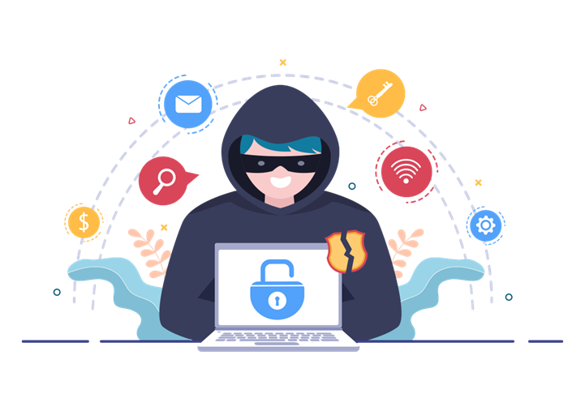
COIT11241 Cyber Security Technologies
Presentation on VPn

Slide 3
VPN
What is VPN?
VPN is simply Virtual Private Network. It's like a shield that wraps around your internet connection and makes it super secure.
Encryption: VPNs use strong encryption to secure data and communications.
Anonymity: VPNs hide users' IP addresses, providing online anonymity.
Remote Access: Allows secure access to private networks from remote locations.
Bypass Restrictions: Helps access geo-blocked content and circumvent internet censorship.
Data Protection: Ensures confidentiality and integrity of data during transmission.
Public Wi-Fi Safety: Provides security when using public Wi-Fi networks.
Multiple Server Locations: VPN services offer servers in various countries for flexibility.
Privacy: Protects user privacy by preventing ISPs and other entities from tracking online activities.
Enhanced Security: Adds an extra layer of protection against cyber threats and hacking attempts.

Slide 4
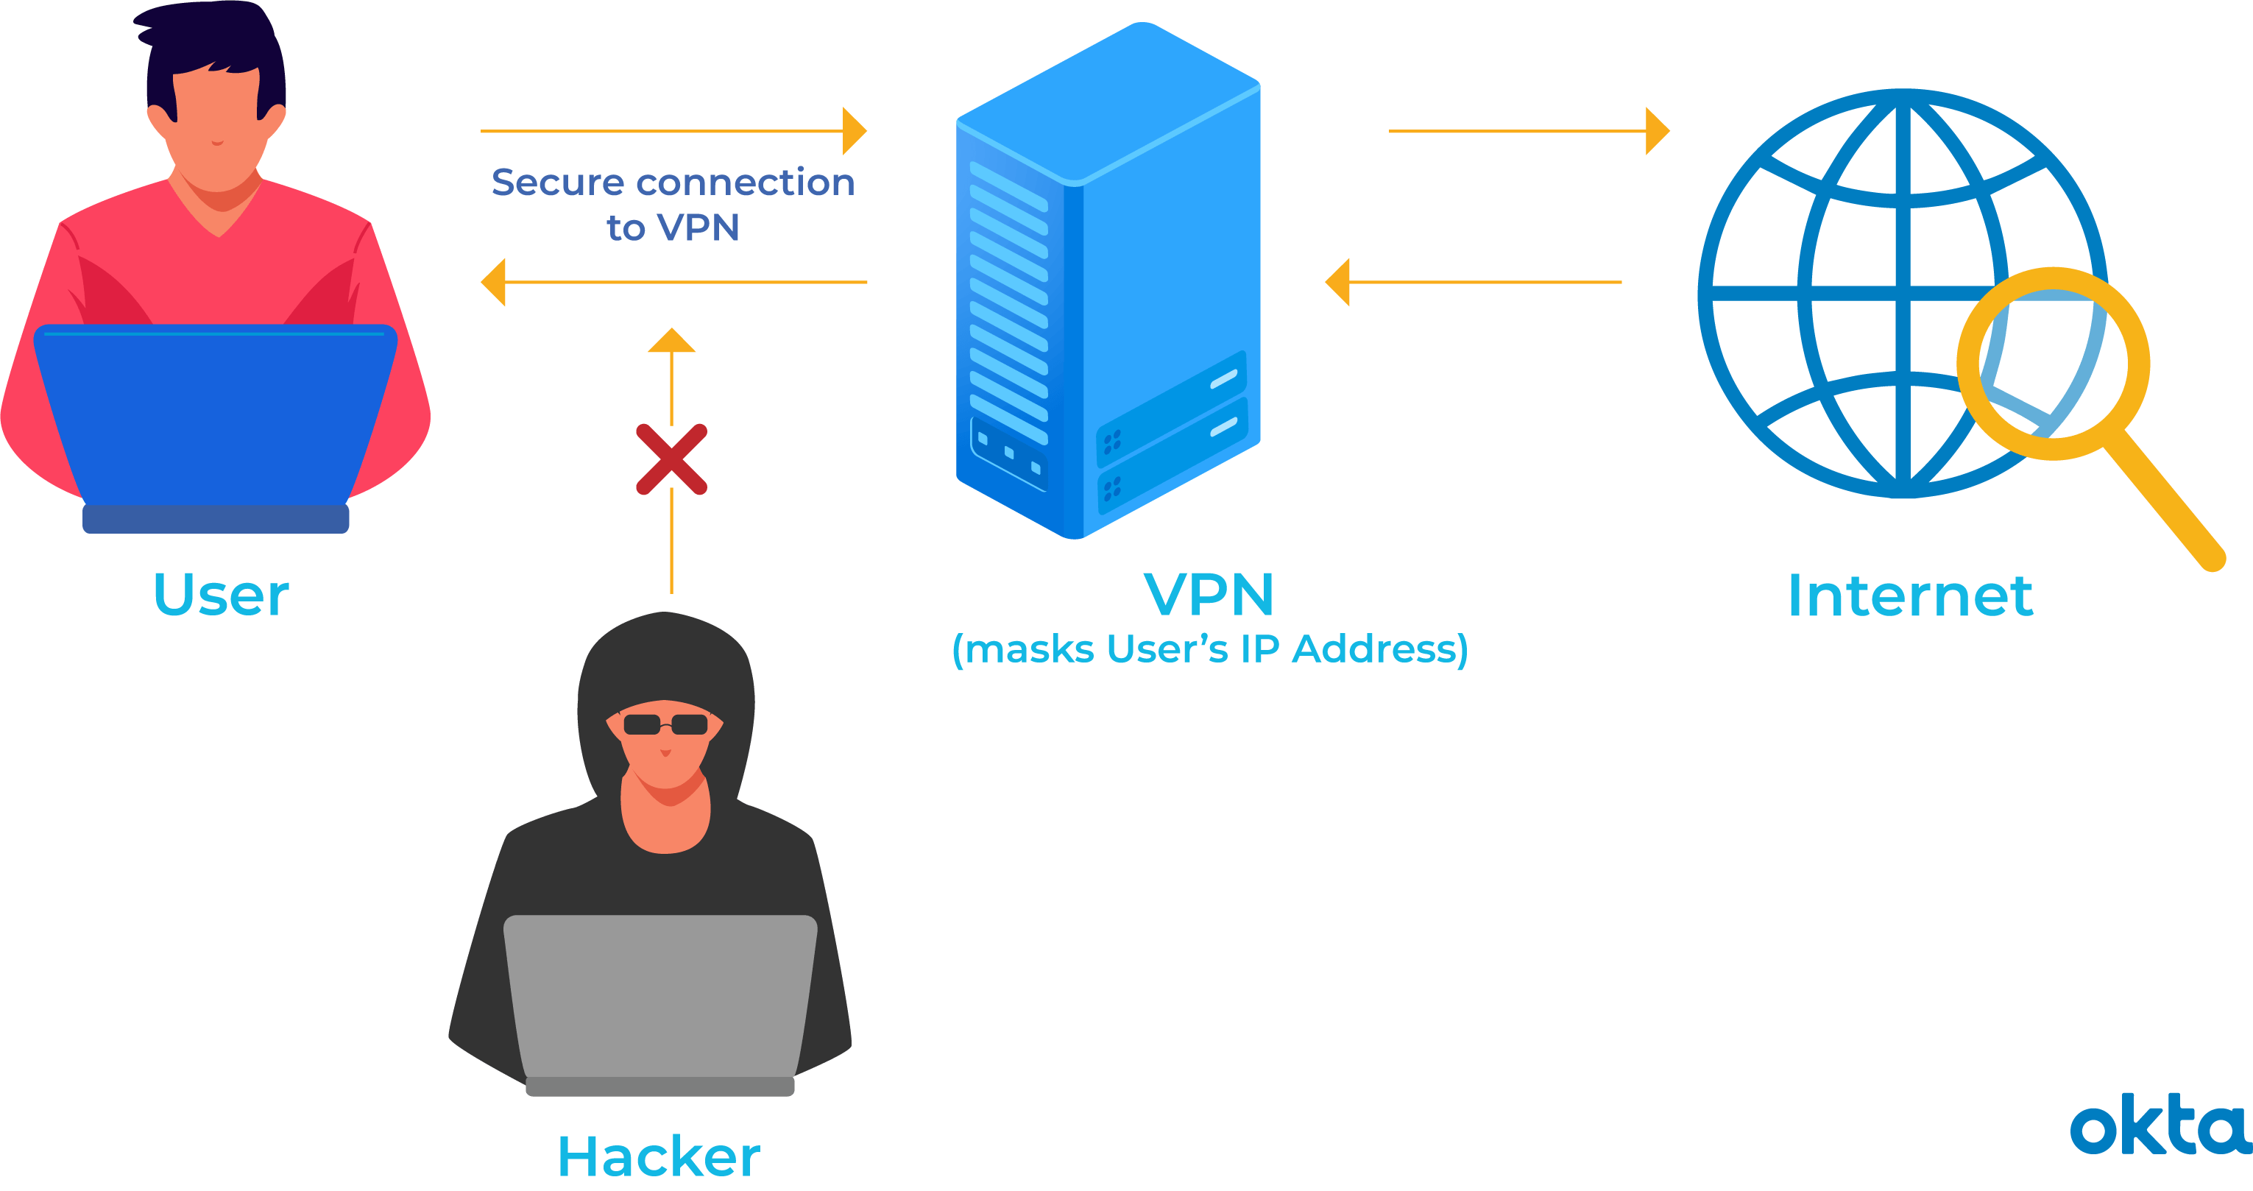
how IT WORKS?
VPN works by creating an encrypted secure tunnel for the connection between the USER and the INTERNET.
It replaces the actual IP address making it look like you are connected from different location.

Slide 5


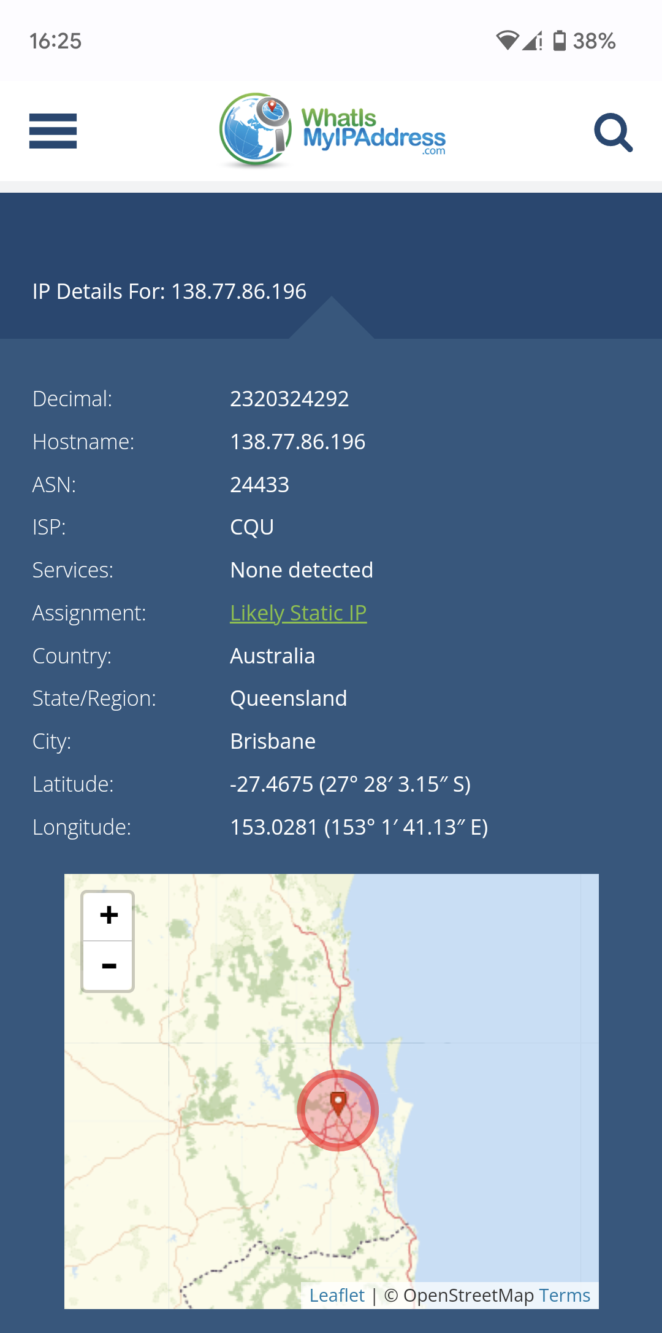
Demonstration
To show how a VPN works, First we need to check our IP address using a website called www.whatismyipaddress.com.
According to the image, we can see that our IP address is 138.77.86.196. The ISP is CQU and the location is Brisbane, Queensland Australia.

Slide 6
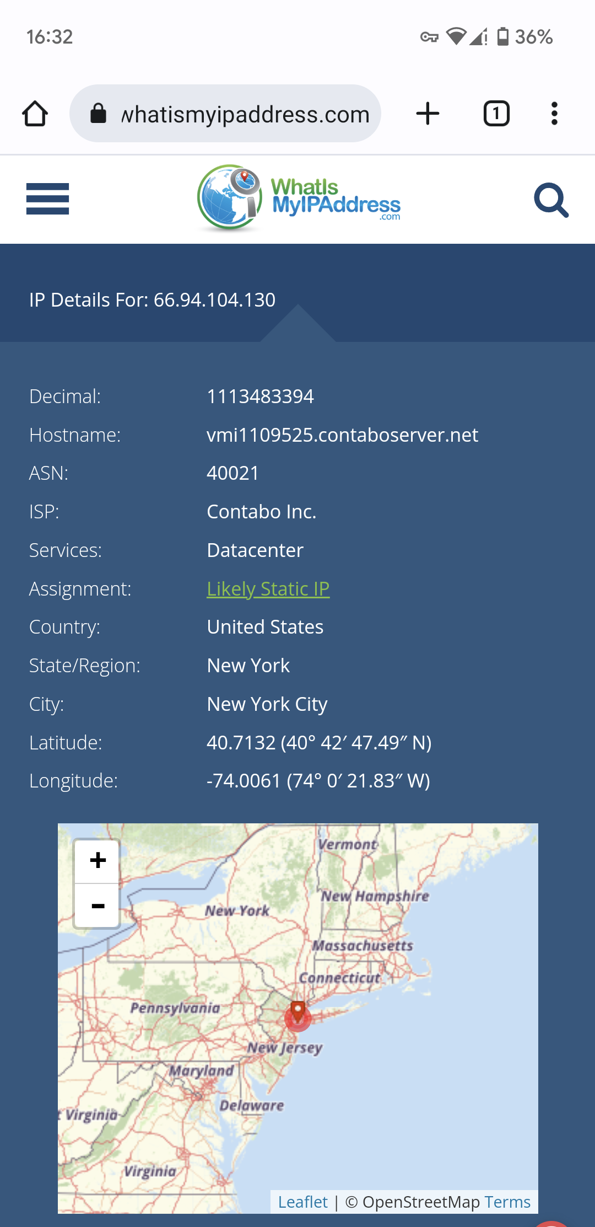
Demonstration CONTD
Now that we know our IP address, we turn on the VPN and check if the IP address is changed.
After connecting to the VPN, the new IP address is: 66.94.104.130.
The location is New York, United States.

Slide 7
How VPN Prevents attack on Mobile.
Imagine you are connected to public Wi-Fi.
Without VPN
The connection is Public and Unsecured
Risks
MAN-IN-THE-MIDDLE (MITM) Attack.
Rogue Hotspots.
Packet Sniffing.
Malware Distribution.
Evil Twin Attacks.
Session Hijacking.

Slide 8
How VPN Prevents attack on Mobile.
Imagine you are connected to public Wi-Fi.
With VPN
The connection is Private, Encrypted and Secured
Benefits
Data Encryption
Secure Browsing
Protections against MAN-IN-THE-MIDDLE attacks.
Anonymity.
Safe Online Transactions.

